Slide 1
Exempt Property Hearings & Receivership Scenarios
Bronson Tucker, General Counsel
Texas Justice Court Training Center

Slide 2



Debt Collection Terminology

Slide 3
Judgment Creditor
  The person in whose favor a judgment was entered or someone who acquired the judgment later.
  It is the person who “holds” the judgment that is being enforced!
  Usually the plaintiff.
  Or an “assignee”
    Someone to whom the judgment was “assigned” after they bought it from the original plaintiff or a prior assignee.

Slide 4
Judgment Debtor
  A person against whom a judgment has been entered.
  Usually the defendant.
  They owe the amount of the judgment to the judgment creditor.

Slide 5

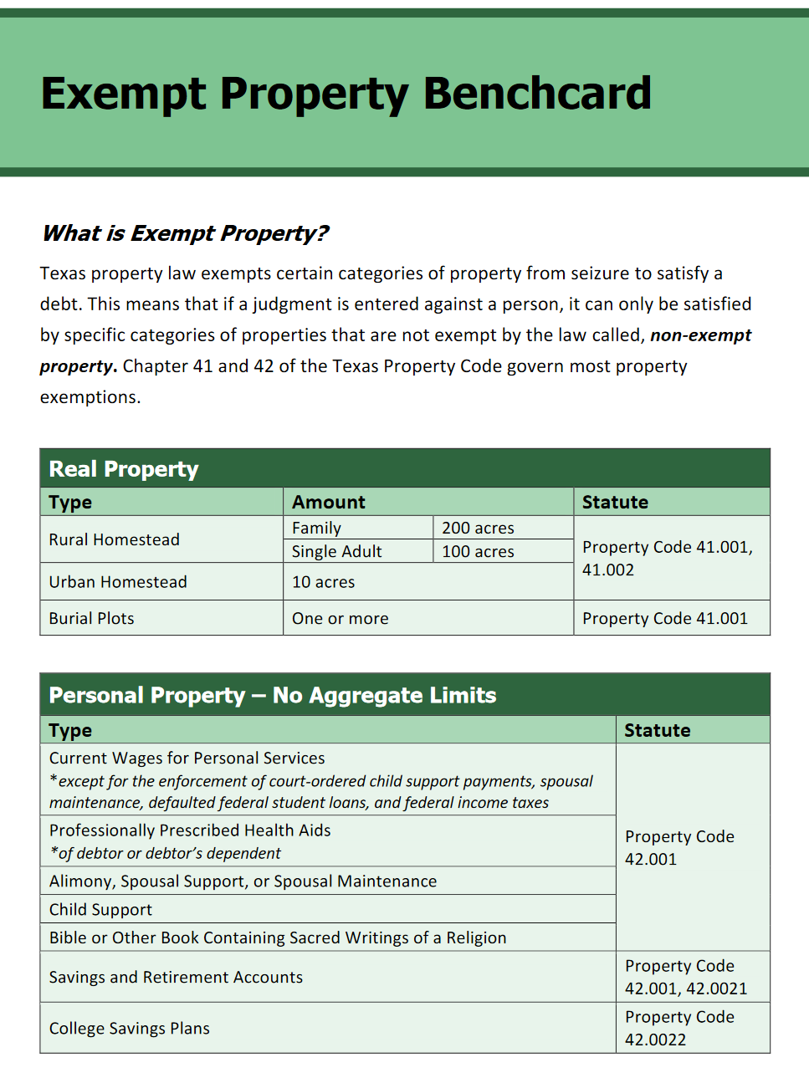
Exempt Property
Exempt property is property that the law allows a person to keep away from creditors if they owe a debt.
Each state chooses what property is exempt.
The types of property are generally those types that would allow a person to keep their job and have a place to live.
https://www.tjctc.org/tjctc-resources/Charts-and-Checklists.html

Slide 6

Common Exempt Property in Texas

Slide 7
Homestead
Each person or family can designate a homestead that will be safe from creditors.
Most people know about this, because there are also property tax benefits to designating a homestead. See https://comptroller.texas.gov/taxes/property-tax/exemptions/residence-faq.php for more info.
Notes:
https://comptroller.texas.gov/taxes/property-tax/exemptions/residence-faq.php

Slide 8
Size of a Homestead
Real Property
Type | Amount |  | Statute
Rural Homestead | Family | 200 acres | Property Code 41.001, 41.002
 | Single Adult | 100 acres
Urban Homestead | 10 acres
Burial Plots | One or more |  | Property Code 41.001

Slide 9
Rural vs. Urban
A homestead is considered to be urban if, at the time the designation is made, the property is:
located within the limits of a municipality or its extraterritorial jurisdiction or a platted subdivision; and
served by police protection, paid or volunteer fire protection, and at least three of the following services provided by a municipality or under contract to a municipality:
  electric; natural gas; sewer; storm sewer; and water.
  Property Code 41.002(c)

Slide 10
Manufactured & Mobile Homes
Generally treated as PERSONAL property!
Owner can elect to treat as real property by following procedures in Property Code 2.001
  Make sure the Statement of Ownership (Occupations Code 1201.207) reflects that the owner has elected to treat as real property; and
  File a certified copy of the Statement of Ownership in the real property records in the county where the home is located
Helpful FAQs for owners can be found at TDHCA’s website: https://www.tdhca.state.tx.us/mh/faqs-sol.htm
Notes:
Texas Department of Housing and Community Affairs - https://www.tdhca.state.tx.us/mh/faqs-sol.htm

Slide 11

Current Wages
Current wages are exempt except for to pay state-ordered child support payments, spousal maintenance, federally guaranteed student loans in default, or federal income taxes owed
  CPRC 63.004
Most often current wage issues come up in garnishment
This Photo by Unknown Author is licensed under CC BY

Slide 12
Current Wages Definition
Current wages are an employee’s pay that is due for personal services
Notice this doesn’t include commissions paid to an independent contractor – Texas courts have held that those are not current wages for personal services
  Campbell v. Stucki, 220 S.W.3d 562, 567 (Tex. App.—Tyler 2007, no pet.); Pitts v. Dallas Nurseries Garden Ctr., Inc., 545 S.W.2d 34, 36 (Tex. Civ. App.—Texarkana 1976, no writ)
Once the money is deposited in a bank account, it is no longer current wages

Slide 13

Retirement, Healthcare, & College Savings Plans
Why do you think these are exempt?
In addition to state law, many of these are covered by federal laws making them exempt.

Slide 14
Commingled Property
If a person mixes exempt and non-exempt property (usually money in a bank account), it may lose its exemption

Slide 15
What about businesses?
Notes:
Businesses don’t have exempt property – LLC, Corp, etc.

Slide 16

HB 3774 & New Rules Related to Exempt Property
This Photo by Unknown Author is licensed under CC BY-NC-ND

Slide 17

What does this mean for justice courts??

Slide 18
Changes to Implement
New judgment forms with the appropriate language
New garnishment notices
New receivership order
Updated forms on TJCTC website
Exempt property hearings
Notice of Protected Property Rights, Protected Property Claim Form, and Instructions must be served by receiver or judgment creditor on the judgment debtor

Slide 19
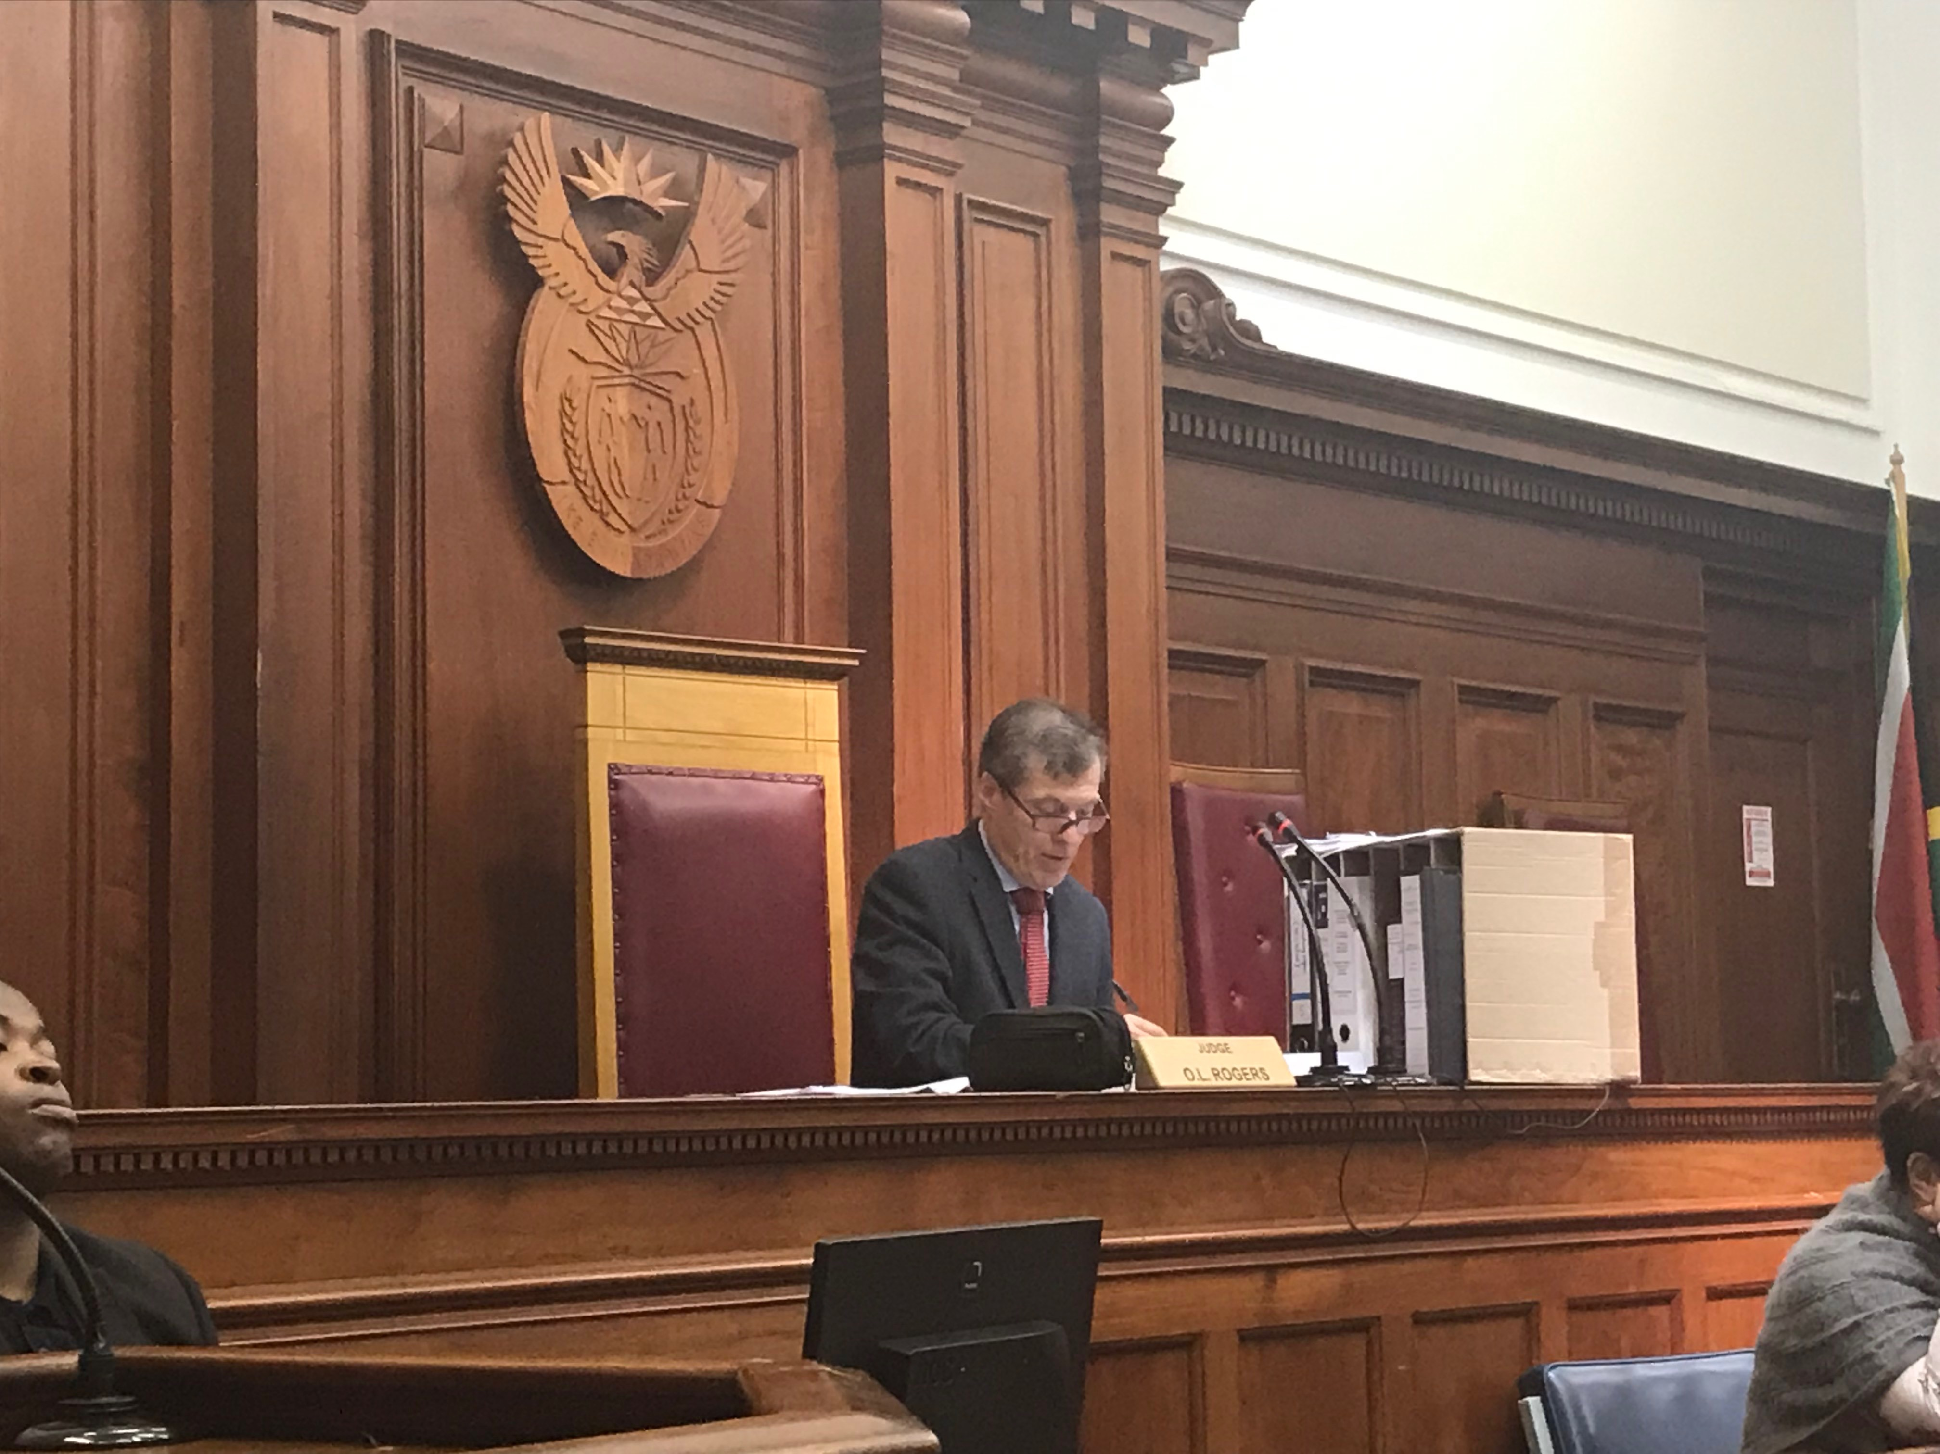
Exempt Property Hearings

Slide 20
Exempt Property Hearing Procedure
Judgment debtor files a Protected Property Claim for or another sworn document with the same information.
Court sets the hearing and notifies the parties (including receivers, constables, or sheriffs involved in the case).
  Hearing must be within 10 days of when the exemption claim was filed unless there is good cause to extend the time.
The receiver or officer cannot sell the judgment debtor’s property until after the court determines the exemption claim.

Slide 21
The Exempt Property Hearing
Burden of Proof
  On the judgment debtor
  Can be met with the sworn statement if it is not challenged
If the court determines the property is exempt, the court must order it released within 3 business days

Slide 22
How do you decide??

Slide 23
Scenario 1
The constable seized 2 vehicles to satisfy a writ against John and Jane Smith. John Smith has filed a Protected Property Claim Form (see Handout 1).
The Smiths argued at the hearing that personal vehicles are on the exempt property list, so the constable shouldn’t be able to seize them.
ABC Holdings’ attorney argues that the Smiths own multiple vehicles, and while some of them are exempt, not all of the vehicles are.
What questions do you ask after the testimony?
How do you rule?
Notes:
They own 5 vehicles, have a 14-year-old daughter and a 10-year-old son at home. No other adults live at the residence. All of the vehicles are in their personal name, even though they own a business.

Slide 24
Scenario 2
You receive another Protected Property Claim Form. Bob Robbins is a fishing guide. He has 4 boats. A receiver has seized all 4 boats to satisfy a judgment against his business, Robbins Fishing Guides, LLC.
What more information do you need?
Are the boats exempt?
Notes:
His business doesn’t have exempt property, so if the boats are in the name of the business – sorry!
May be more complicated if

Slide 25

Resources

Slide 26
Forms
Exempt Property Claim Form (Texas Supreme Court)
Exempt Property Claim Form – Instructions (Texas Supreme Court)
Notice of Protected Property Rights (Bilingual; Texas Supreme Court)
Updated judgment forms for all money judgments
Updated garnishment forms
All forms can be found on TJCTC Forms Page: https://www.tjctc.org/tjctc-resources/forms.html

Slide 27
Exempt Property Self-Paced Module
https://www.tjctc.org/onlinelearning/selfpacedmodules.html

Slide 28

Receivership Scenarios

Slide 29
Scenario 1 – Appoint?
A judgment is rendered against a defendant by the Justice of the Peace in Apple County Precinct 1.
You are the judge in Apple County Precinct 2 and the judgment creditor comes in asking you to appoint a receiver in this case. They say that the Precinct 1 judge hates plaintiffs and refuses to appoint receivers.
Should you appoint a receiver here? Why or why not?

Slide 30
Scenario 2 – Appoint?
A judgment creditor asks for appointment of a receiver. The application doesn’t state that the defendant possesses non-exempt property. You ask at a hearing if the defendant has any non-exempt property and the judgment creditor responds “I don’t know, that’s why I need a receiver, so I can find out!”
Appoint? Why or why not?

Slide 31
Scenario 3 – Form?
A judgment creditor wants you to use their form in appointing a receiver, instead of the one from the TJCTC site. They say that form is too confusing, and they also disagree with some of the items. They also say that it is their judgment, their motion, and they are the one at risk.
Use their form or the TJCTC form?

Slide 32
Scenario 4 – Fees?
Should you charge for an application for a receiver?
Can the requesting party request attorney’s fees?
The requesting party wants the order appointing the receiver to include the receiver’s fee. Is this appropriate? What amount would you award, if so? Anything else that needs to happen?

Slide 33
Scenario 5 – Extension?
A receiver requests an extension of the receivership, which you originally set at 90 days.
What are some reasons you would grant this request?
What are some reasons you would not grant this request?

Slide 34
Scenario 6 – Exempt Property Claim
Your court appoints a receiver and the judgment debtor comes in and claims that the receiver has taken funds from the defendant’s account that were exempt, as they were SSDI funds.
What does the court do now?

Slide 35
Scenario 7 – No Warning
Your court renders a judgment against a defendant, which does not contain the statutorily-mandated warnings about exempt property. The defendant later has property seized under a writ of execution and sold.
They have now come in and claimed that the property was exempt, and that your court didn’t warn them and so your court needs to fix the problem. What do we do?

Slide 36

Questions?

